Slide 1
SegNet : A Deep Convolutional Encoder-Decoder Architecture for Image Segmentation, IEEE Transaction 2017
COMPUTER VISION LAB
22211226 JHNam

Slide 2
CONTENT
Introduction
Architecture
Benchmarking

Slide 3
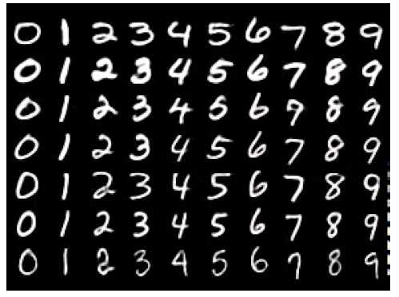
Introduction
Deep Learning Applications
Hand Written Digit Recognition

Slide 4

Introduction
Deep Learning Applications
Speech Recognition

Slide 5

Introduction
Deep Learning Applications
Object Detection

Slide 6
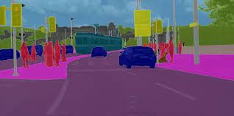
Introduction
Deep Learning Applications
Segmentation

Slide 7
Introduction
Challenge in Segmentation
Max Pooling + Subsampling ⇒ Feature map resolution ↓
SegNet
Low resolution features to input resolution for pixel-wise classification.
Efficient Architecture for pixel-wise Semantic Segmentation

Slide 8
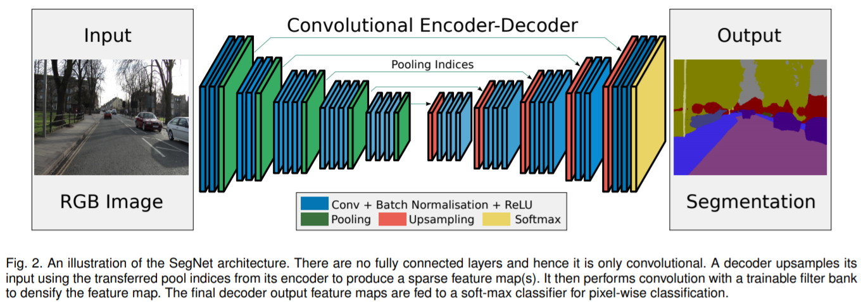
Architecture
SegNet Overall Architecture
Encoder + Decoder + Final pixel-wise classification

Slide 9
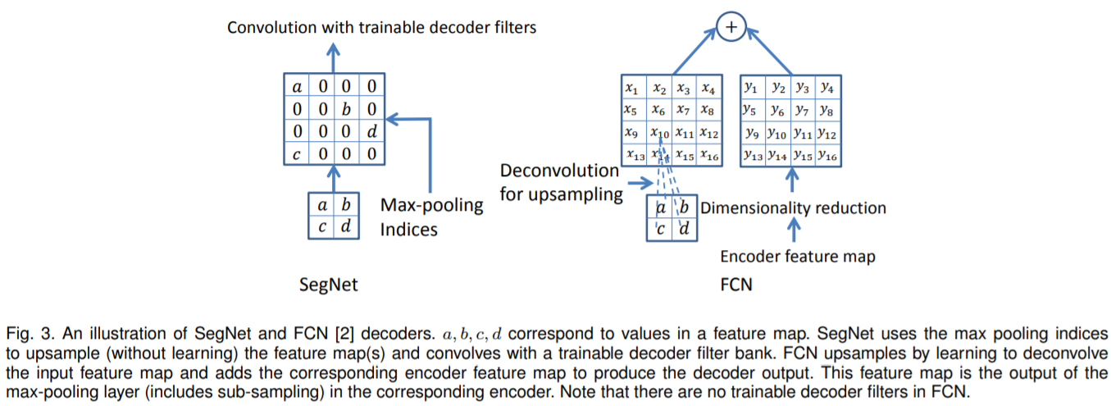
Architecture
SegNet Encoder
13 Convolutional Layers which correspond to the first 13 convolutional layers in the VGG16.
Discarding FCL : #Parameter ↓(134M ⇒ 14.7M)
Each encoder layer has a corresponding decoder layer
Decoder network has 13 layers.
Conv → Batch Norm → ReLU → Max Pooling
Max Pooling : Achieve translation invariance over small spatial shifts in the input image.
Max Pooling ⇒ Boundary Detail ↓ ⇒ Not beneficial for segmentation where boundary delineation is vital ⇒ Capture and Store Boundary Information
Storing only the Max Pooling indices.

Slide 10
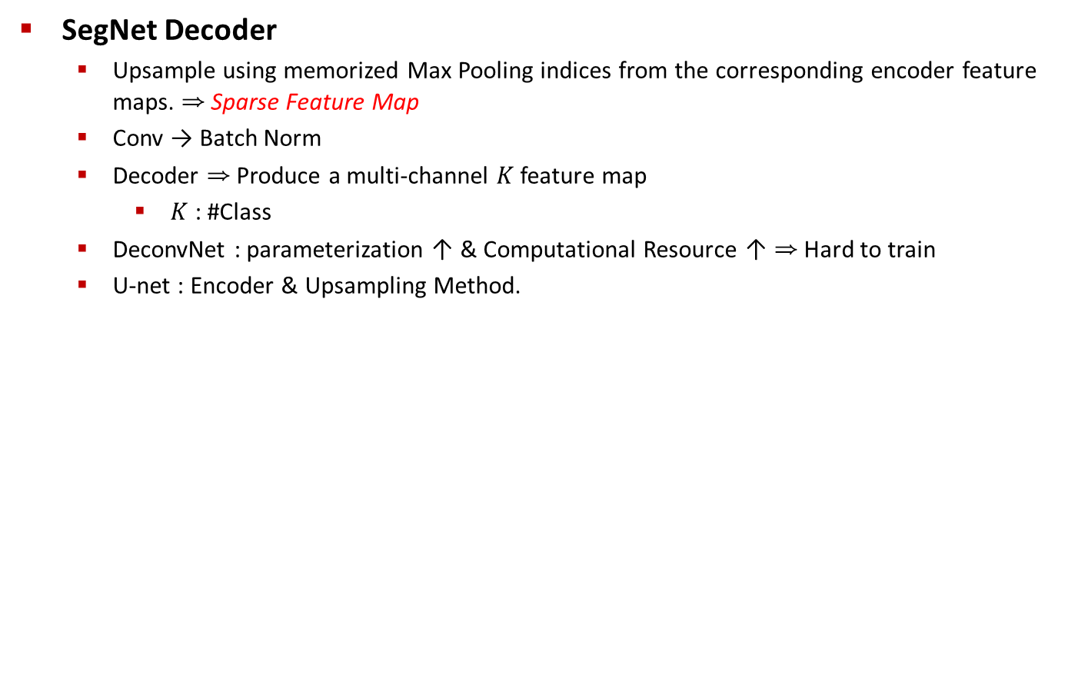
Architecture

Slide 11
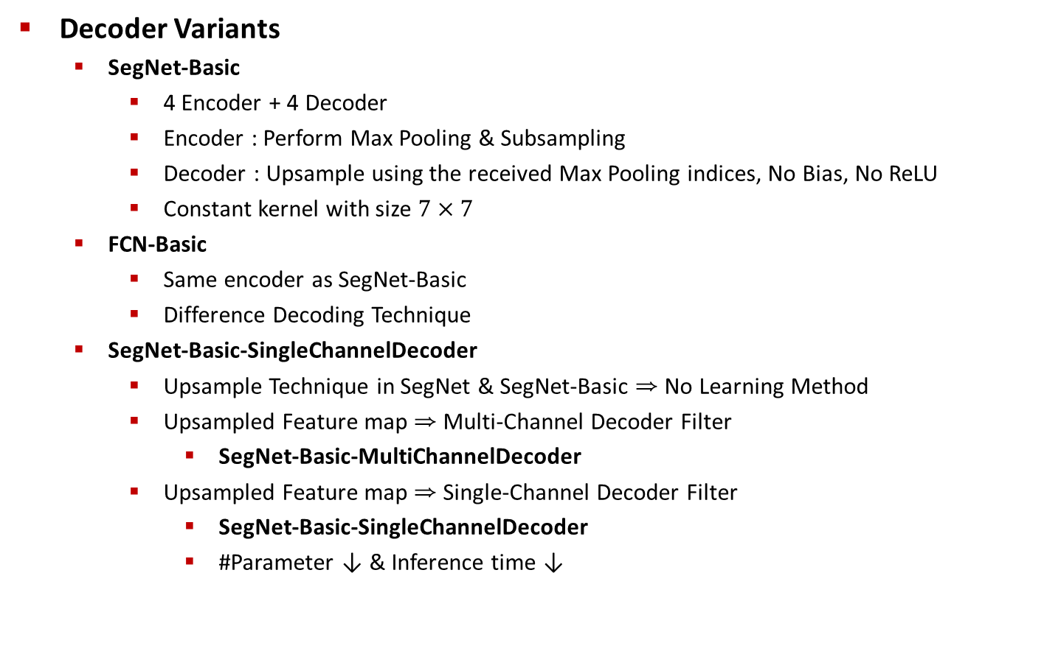
Architecture

Slide 12
Architecture
Decoder Variants
FCN-Basic-NoAddition
FCN Decoder ⇒ Need to store encoder feature maps during inference
Memory Usage ↑ ⇒ Not applicable for embedded system
Apply Dimensionality Reduction : 64 feature maps(11MB) → 11 feature maps(1.9MB)
SegNet : Save only Max Pooling indices ⇒ Require only 0.17MB
Discard feature map addition step ⇒ FCN-Basic-NoAddition
Bilinear-Interpolation
SegNet-Basic-EncoderAddition
Add 64 encoder feature maps at each layer to the corresponding output feature maps at each layer to the corresponding output feature maps from the SegNet decoder to create a more memory intensive.
FCN-Basic-NoDimReduction
More Memory Intensive FCN-Basic Variant
Other Generic Variant : Replication

Slide 13
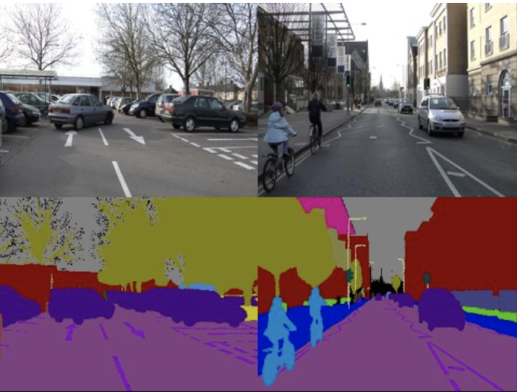
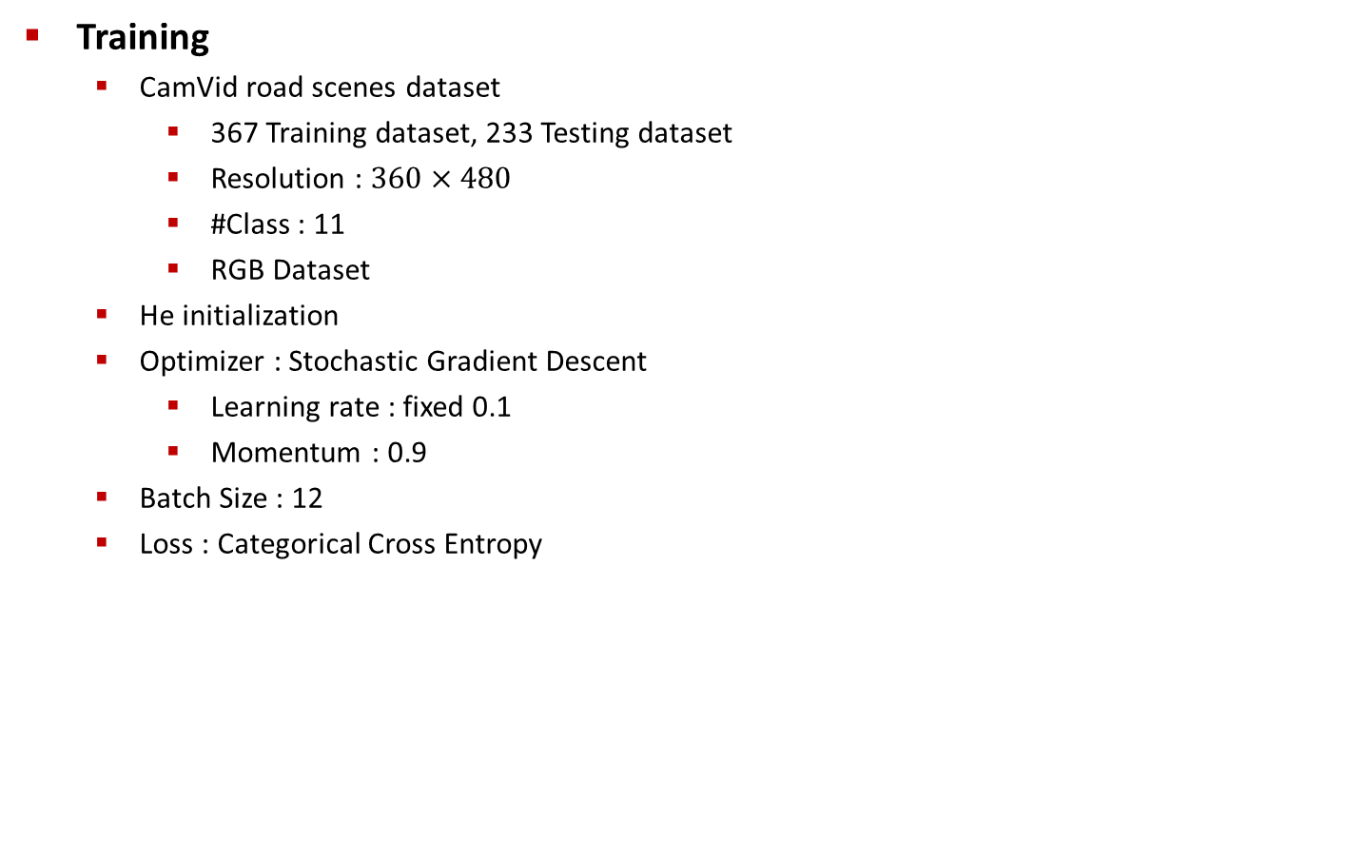
Architecture

Slide 14
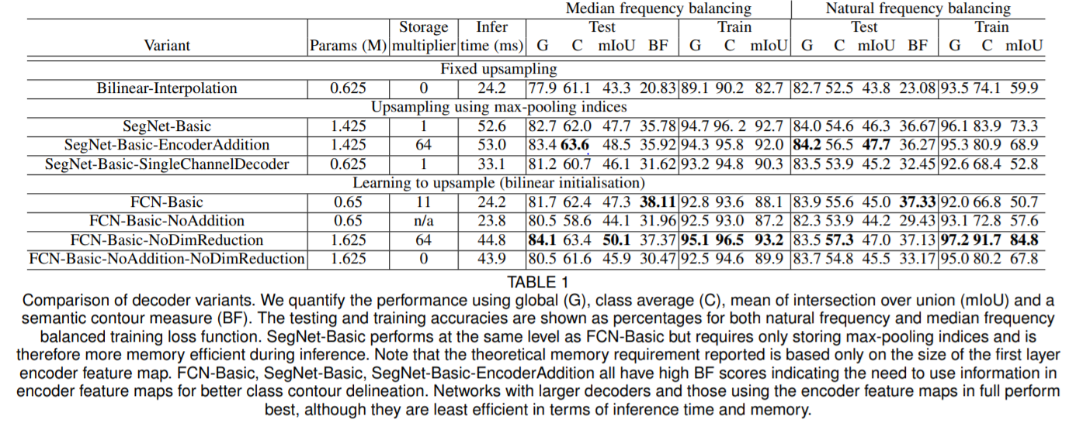
Architecture
Analysis
Compare the quantitative performance of the different decoder
Performance Measure
Global Accuracy(G) : Measures the percentage of pixels correctly classified in the dataset
Class Average Accuracy(C) : Mean of the predictive accuracy over all classes
mIoU, Boundary F1 Score
Overall Numerical Result

Slide 15
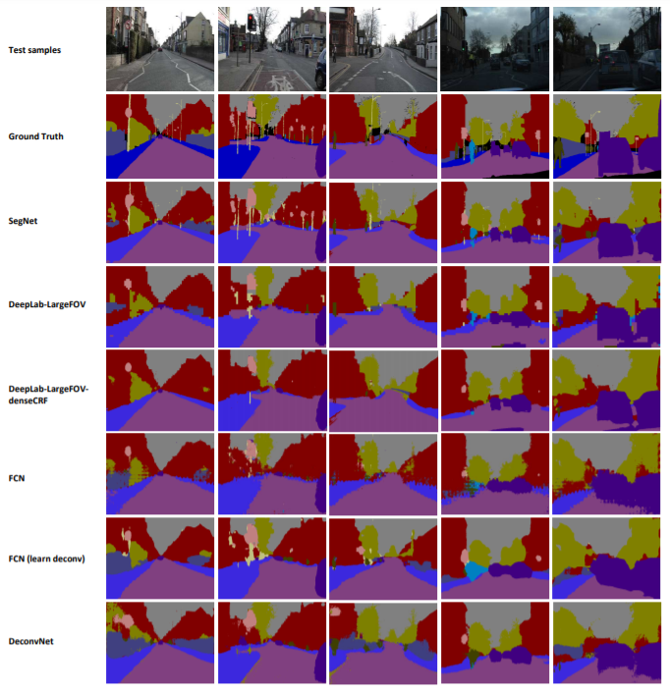
Benchmarking
Road Scene Segmentation

Slide 16
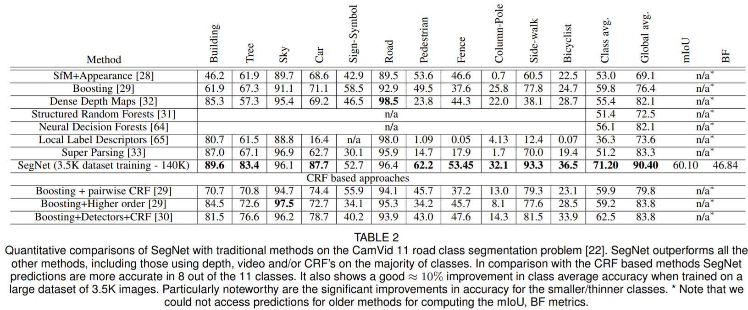
Benchmarking
Road Scene Segmentation

Slide 17
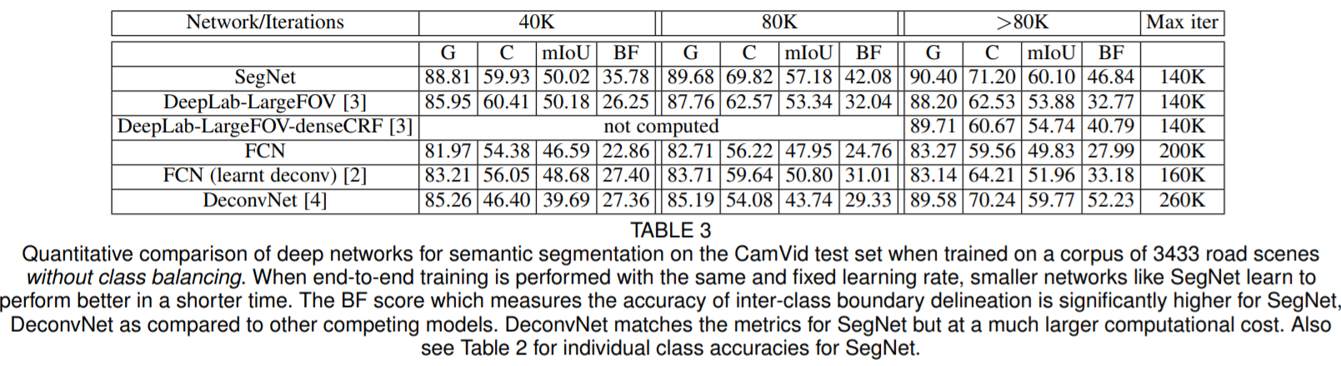
Benchmarking
Road Scene Segmentation

Slide 18
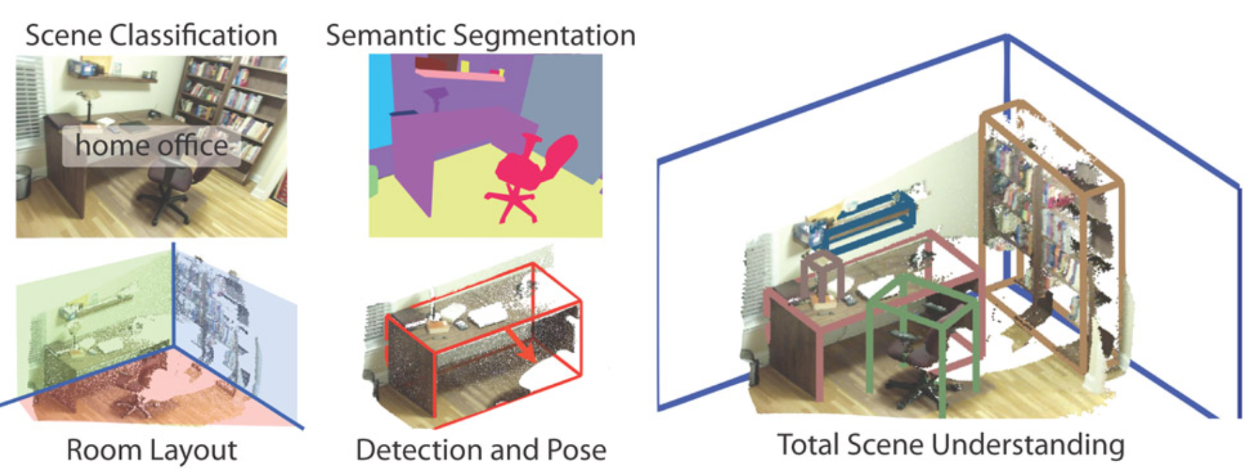
Benchmarking
Sun RGB-D Indoor Scene

Slide 19
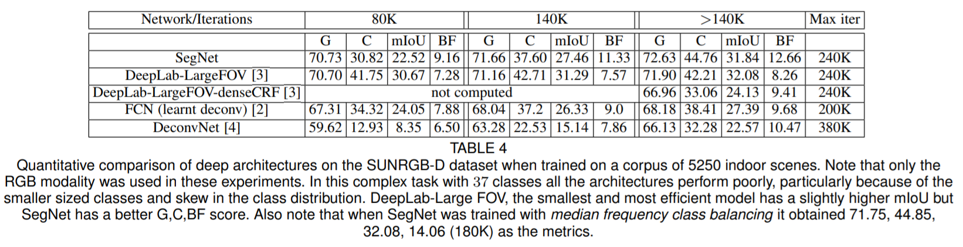
Benchmarking
Sun RGB-D Indoor Scene

Slide 20
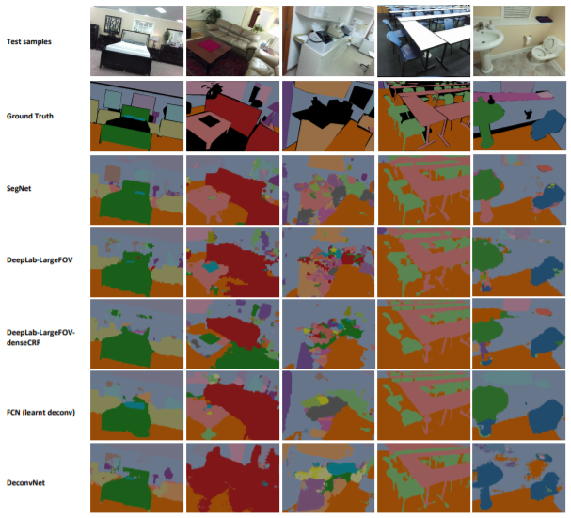
Benchmarking
Sun RGB-D Indoor Scene

Slide 21
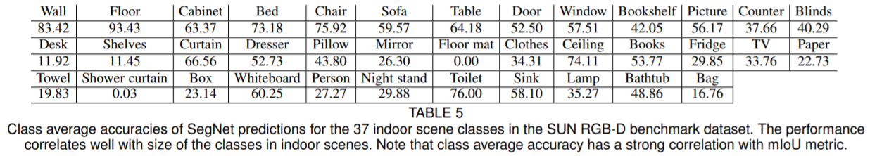
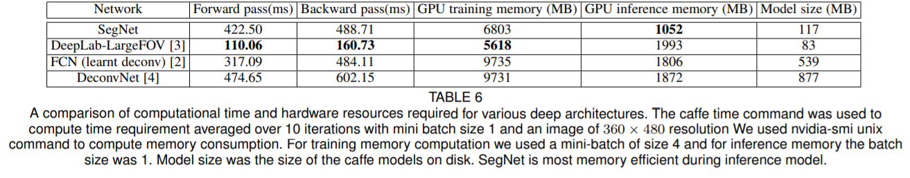
Benchmarking
Sun RGB-D Indoor Scene

